Slide 1
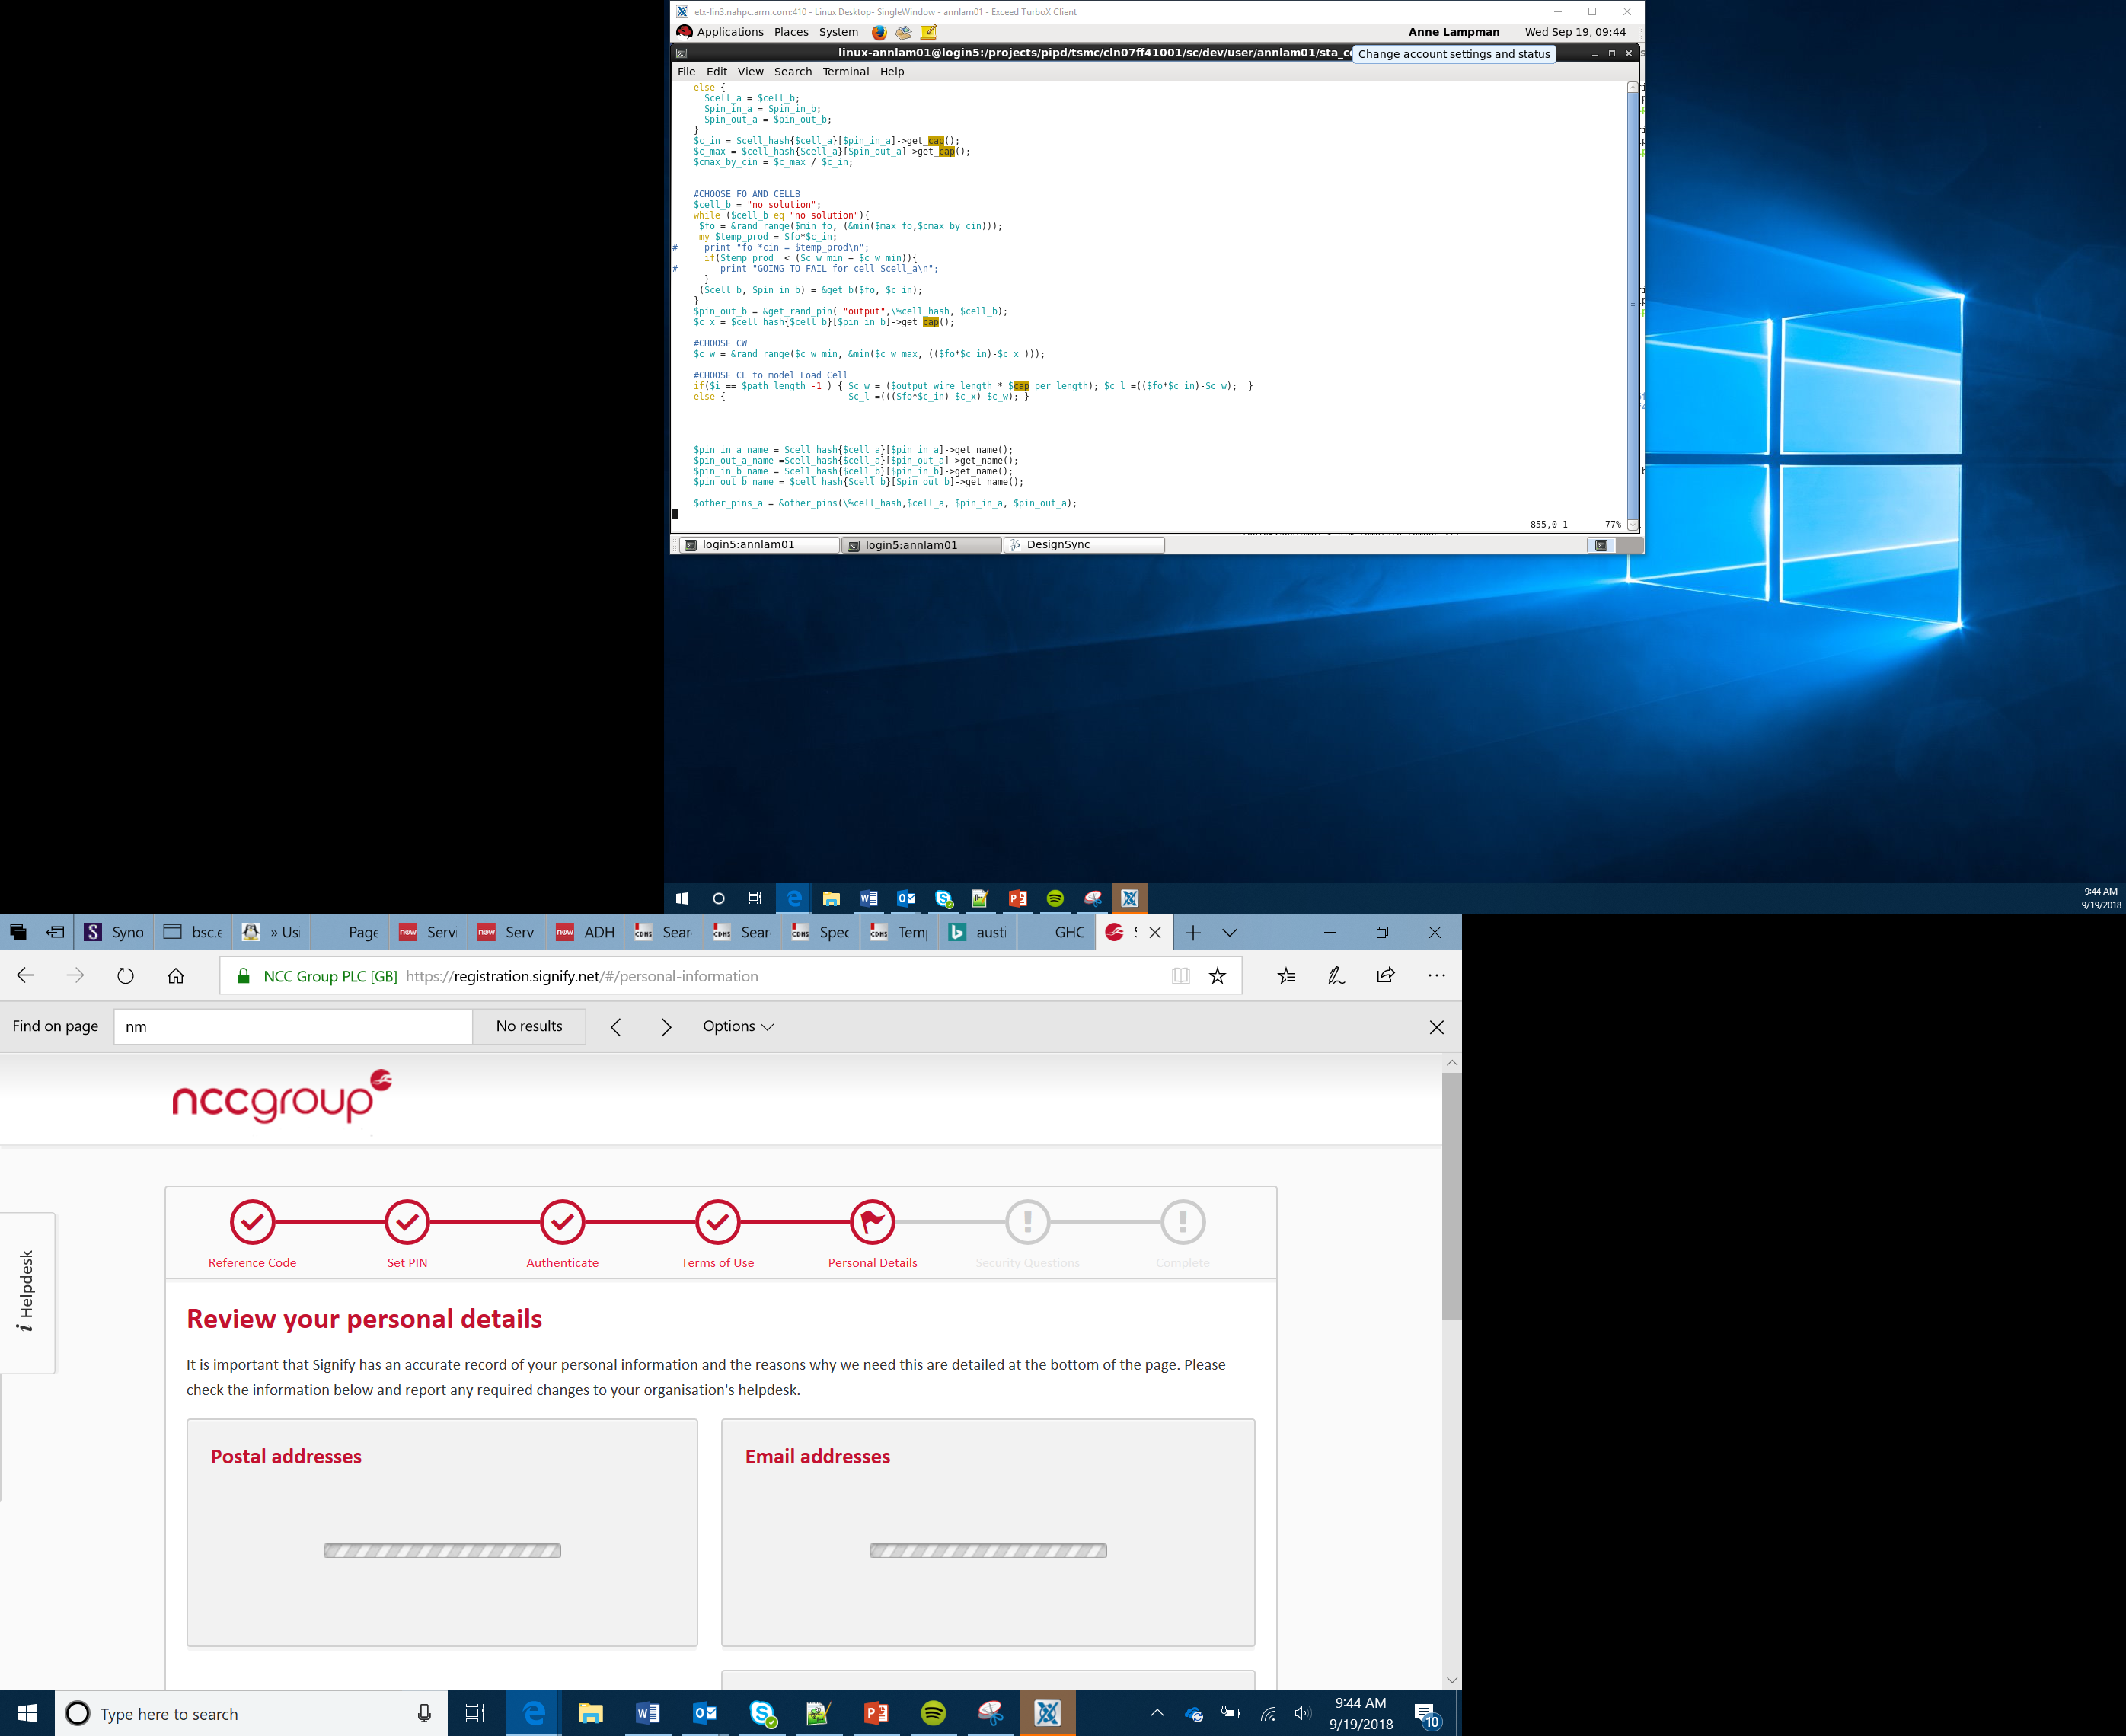

Getting Started
Lesson 1

Slide 2
What the Lesson Will Cover
Introduction to the course
Theory and project lessons
Success criteria
Micro:python
Text based vs blocks
Getting started with micro:bit and MicroPython
Know what an IDE is
Scroll text and display images on the micro:bit
Notes:
Introduce the lesson and what it will cover, Learners could discuss or ask question about what the lesson might involve.

Slide 3
Theory lessons and project
Theory lessons
Projects
Learning about core theory
Covers computational techniques
Includes activities with success criteria
Typically done individually
Group tasks (typically groups of 4)
Requires teamwork and communication
Must work in parallel
Clear success criteria for both software and hardware
Typically involves designing and building a product to solve a problem

Slide 4
Success criteria
These are the key objectives for the lesson/project
You need to plan your time to meet these criteria
Use these to check progress

Slide 5
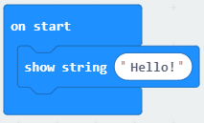
Blocks to code
=
from microbit import *
display.scroll(‘Hello!’)

Slide 6
Indentation for formatting
from microbit import *
boat = Image('09090:'
'09090:'
'09090:'
'99999:'
'09990')
display.show(boat)
or
boat = Image('09090:''09090:' '09090:' '99999:' '09990')

Slide 7
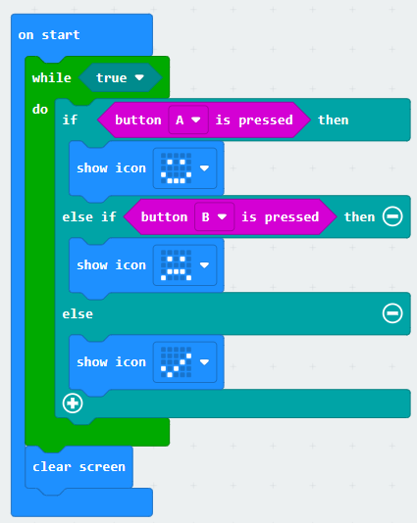
Indentation
from microbit import *
while True:
if button_a.is_pressed():
display.show(Image.HAPPY)
elif button_b.is_pressed():
display.show(Image.SAD)
else: display.show(Image.YES)
display.clear()
=

Slide 8
Case sensitivity and special characters
Microbit, microbit and microBit are all different things!
If you get a ‘NameError’ then you have mistyped something.
‘ and : are special characters, ensure you haven’t added them by mistake or have missed them where they are needed
Be careful with full stops (.) as these will confuse Python if you use them inappropriately

Slide 9
Troubleshooting
Python needs you to type in the code perfectly
It will display error messages and try to tell you what line the error is on (this isn’t always right!)
If you get a SyntaxError then you have typed something that Python doesn’t understand
If the micro:bit freezes – turn it off and on again (power cycle)

Slide 10
Success criteria
Look at the Python code and match it to the blocks version
Find online the Python syntax for the code block examples
Notes:
Learners work through the activity sheet

Slide 11
What is an IDE
IDE stands for Integrated Development Environment
It provides ‘tools’ to hep you to code
Common features of an IDE are:
Code editor – this enables you to write your program
Error checker / debugger – this checks your code and highlights errors
Auto complete / code snippets – this provides examples of code or automatically completes your line of code as you are typing it out
Runtime environment – this enables you to run your program and see the output
Notes:
Discuss with Learners the various features of the IDE, they may have used one with other programming languages so can compare the features.
You could compare the IDE with a text editor to highlight the differences.

Slide 12
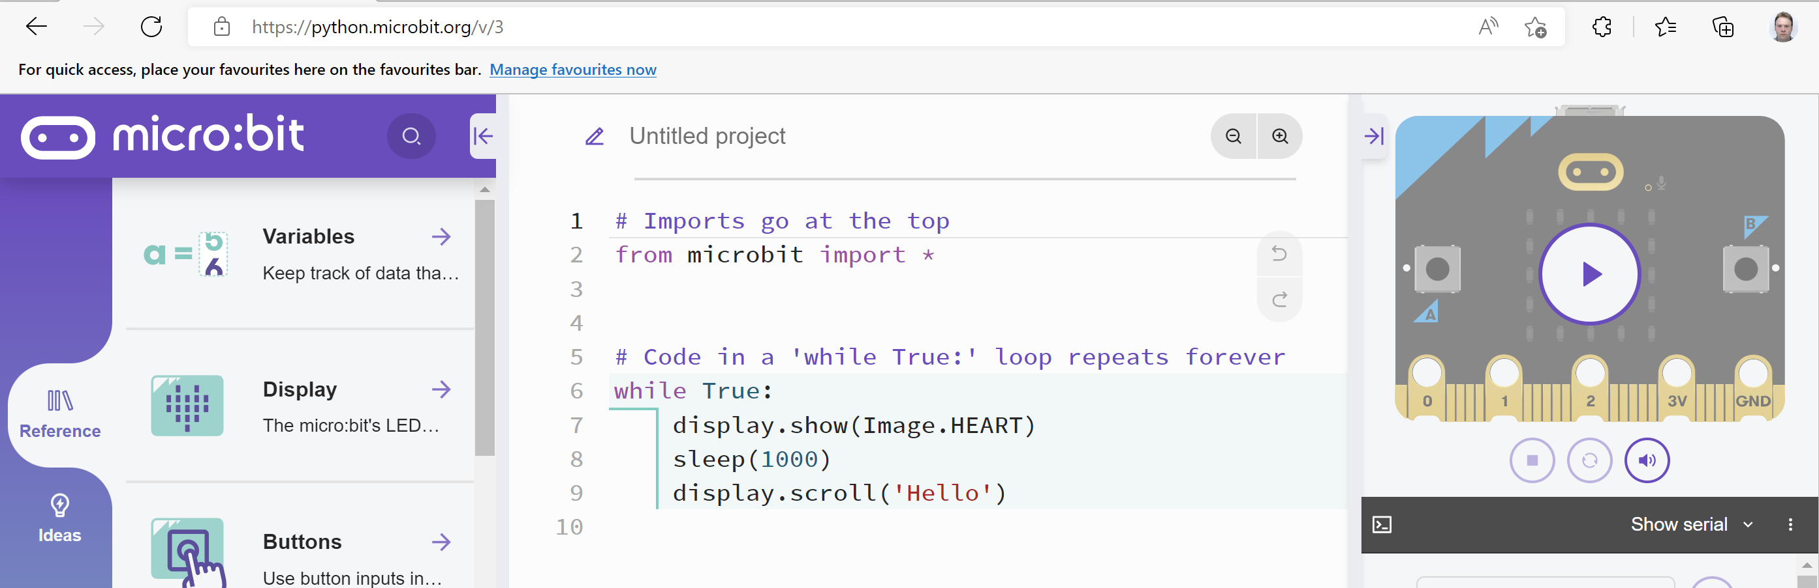
The MicroPython Editor
Notes:
Explain that there are different IDEs for different programming languages, perhaps Learners could find out the names of some for Homework.
Ensuring that MakeCode and the MicroPython editor are available before you start
Ensure the following website are unfiltered (a constantly updated list is available at https://support.microbit.org/support/solutions/articles/19000030385-firewall-whitelist-requirements-for-micro-bit-editors)
You need access to USB devices if these are blocked by default all Micro:bits use the same ID – use your security policy to exempt the micro:bit ID
PXT / MakeCode/Javascript Blocks Editor:
pxt.microbit.org
makecode.microbit.org
makecode.com www.pxt.io trg-microbit.userpxt.io pxt.azureedge.net
github.com Blocks:
www.microbit.co.uk
Touch Develop:
www.microbit.co.uk
Code Kingdoms:
www.microbit.co.uk
microbit.codekingdoms.com
Python Web Editor (microbit.org)
https://python.microbit.org

Slide 13
Hello World – Writing Your First Program
Open the online editor https://python.microbit.org/v/3
What do you think lines, 5, 6 and 7 do?
Download the program code to your micro:bit
Did it do what you thought?
Notes:
Hello World is considered the first beginners program, similar to taking your first step as a toddler.
Downloading the code is covered in the Activity Sheet.

Slide 14
Hello World – Make Your Own
# Add your Python code here.
from microbit import *
while True:
display.scroll('Hello, World!')
sleep(2000)
Edit line 3 to create your own message
Can you display two or more messages?
Notes:
Ensure that the indentation levels match, this is the whitespace before the line of code. Usually it is one ‘TAB’ key or ‘four space bar’ presses.
It is important that the level of indentation is consistent for each program. (One TAB or Four spaces)
Indentation also occurs on the next line after the colon : symbol, in the program above, after the while True:
Most errors in the programs will be caused by the indentation levels being incorrect so support students to get them write in these first few programs.

Slide 15
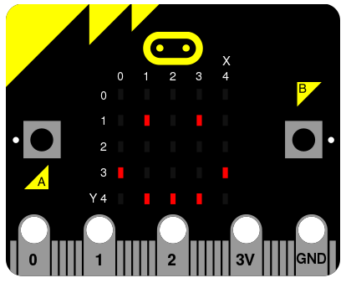
Displaying Images
Notes:
By turning LEDs on and off you can create images, similar to pixels on a screen that can be built up to create images.

Slide 16
Displaying Images
Images are built up by turning the LEDs ON or OFF
There are pre built images which can used
The line of code is display.show(Image.HEART)
Try the program below, download it to your micro:bit and run it:
from microbit import *
while True:
display.show(Image.HEART)
sleep(2000)

Slide 17
Displaying Images – Try Some Of These
Replace the image with one of the pre-made ones:
Image.HEART, Image.HEART_SMALL, Image.HAPPY, Image.SMILE, Image.SAD, Image.CONFUSED, Image.ANGRY, Image.ASLEEP, Image.SURPRISED. Image.SILLY
Image.FABULOUS, Image.MEH. Image.YES, Image.NO, Image.TRIANGLE, Image.CHESSBOARD, Image.DIAMOND, Image.PITCHFORK, Image.XMAS, Image.PACMAN, Image.TARGET
Image.TSHIRT, Image.ROLLERSKATE, Image.DUCK, Image.HOUSE, Image.TORTOISE, Image.BUTTERFLY, Image.STICKFIGURE, Image.GHOST, Image.SWORD, Image.GIRAFFE
Image.SKULL, Image.UMBRELLA, Image.SNAKE
Notes:
Learners can replace the name of the image with some of the ones above, see what happens.

Slide 18
Activity
Use these skills to build a simple message machine
Notes:
Learners work through the activity sheet

